Slide 1
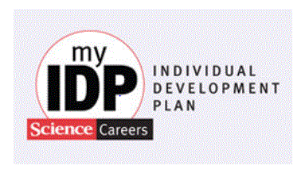
Marnie Saunders, PhD
Senior Associate Dean, The Graduate School
myIDP (Sciences): A Graduate Student Information Session

Slide 2
IDP – Individual Development Plan
A web-based career-planning tool for graduate students and postdoctoral fellows in the sciences
myidp.sciencecareers.org
imaginephd.com
Disclaimer – all information in these slides are taken directly from the website and the companion articles by Hobin, Fuhrmann, Lindstaedt, and Clifford

Slide 3
Today’s Challenges
The share of all US science and engineering doctorate recipients working in academia dropped from 55% to 44% between 1973 and 2008
The proportion of scientists employed in tenure or tenure-track positions has also declined – likely reflecting a growth in postdoctoral, staff scientist and other non-tenure positions
Graduate students and postdocs need to master new skill sets to compete successfully for research positions both within and outside academia

Slide 4
Today’s Challenges
Placing a greater importance on ‘transferable’ skills, such as leadership, management and communication
These skills can be difficult to acquire and document during academic training
You need a deliberate plan!
Research finds that people who develop and implement strategies to pursue career-specific goals achieve greater success as measured by salary, promotions and level of responsibility

Slide 5
Today’s Challenges
Survey of 7600 postdoctoral researchers found that postdocs who developed training plans with their advisors at the start of their appointments reported greater satisfaction, published more papers and experienced fewer conflicts with those advisors
Developed by Science, based upon FASEB plan for postdoctoral fellows
‘helped not just to decide on a goal, but to have the goal in mind all the time’

Slide 6
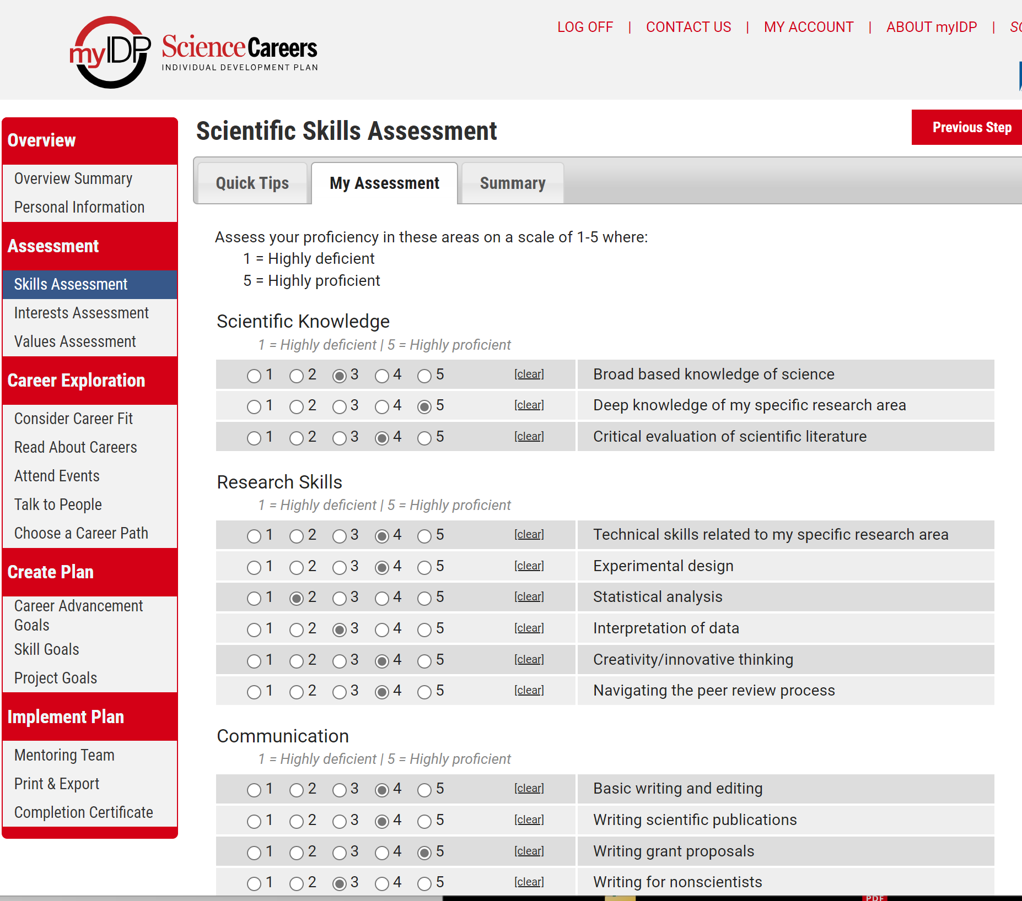

Slide 7
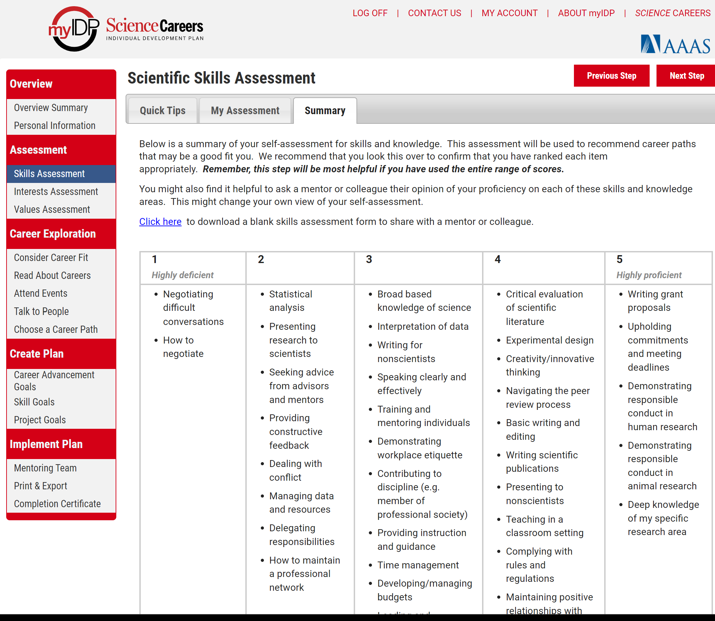

Slide 8
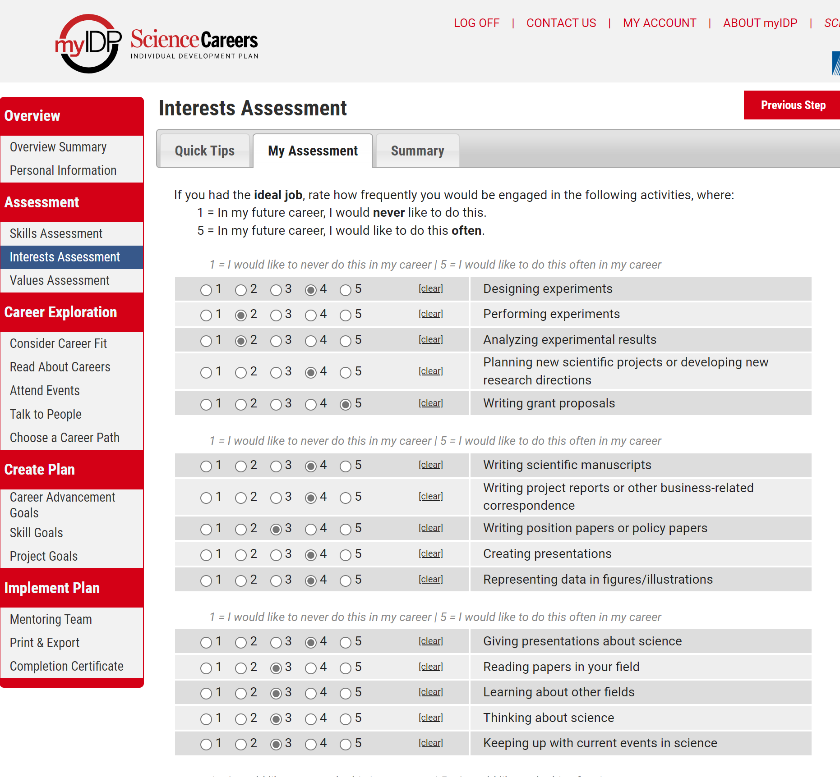

Slide 9
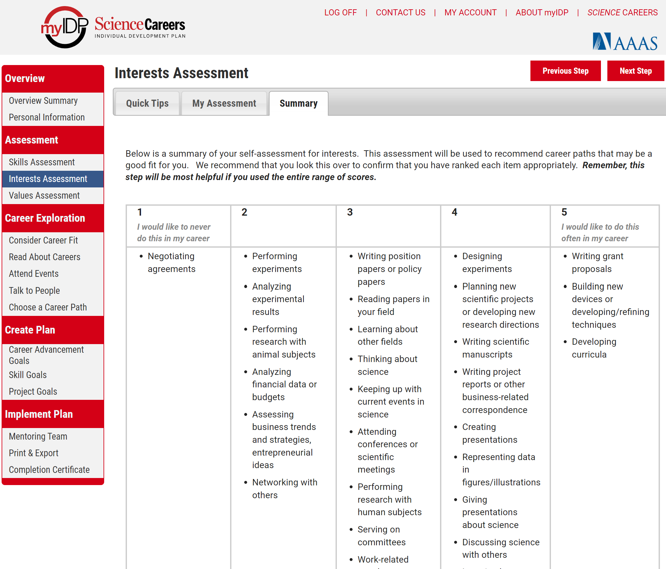

Slide 10
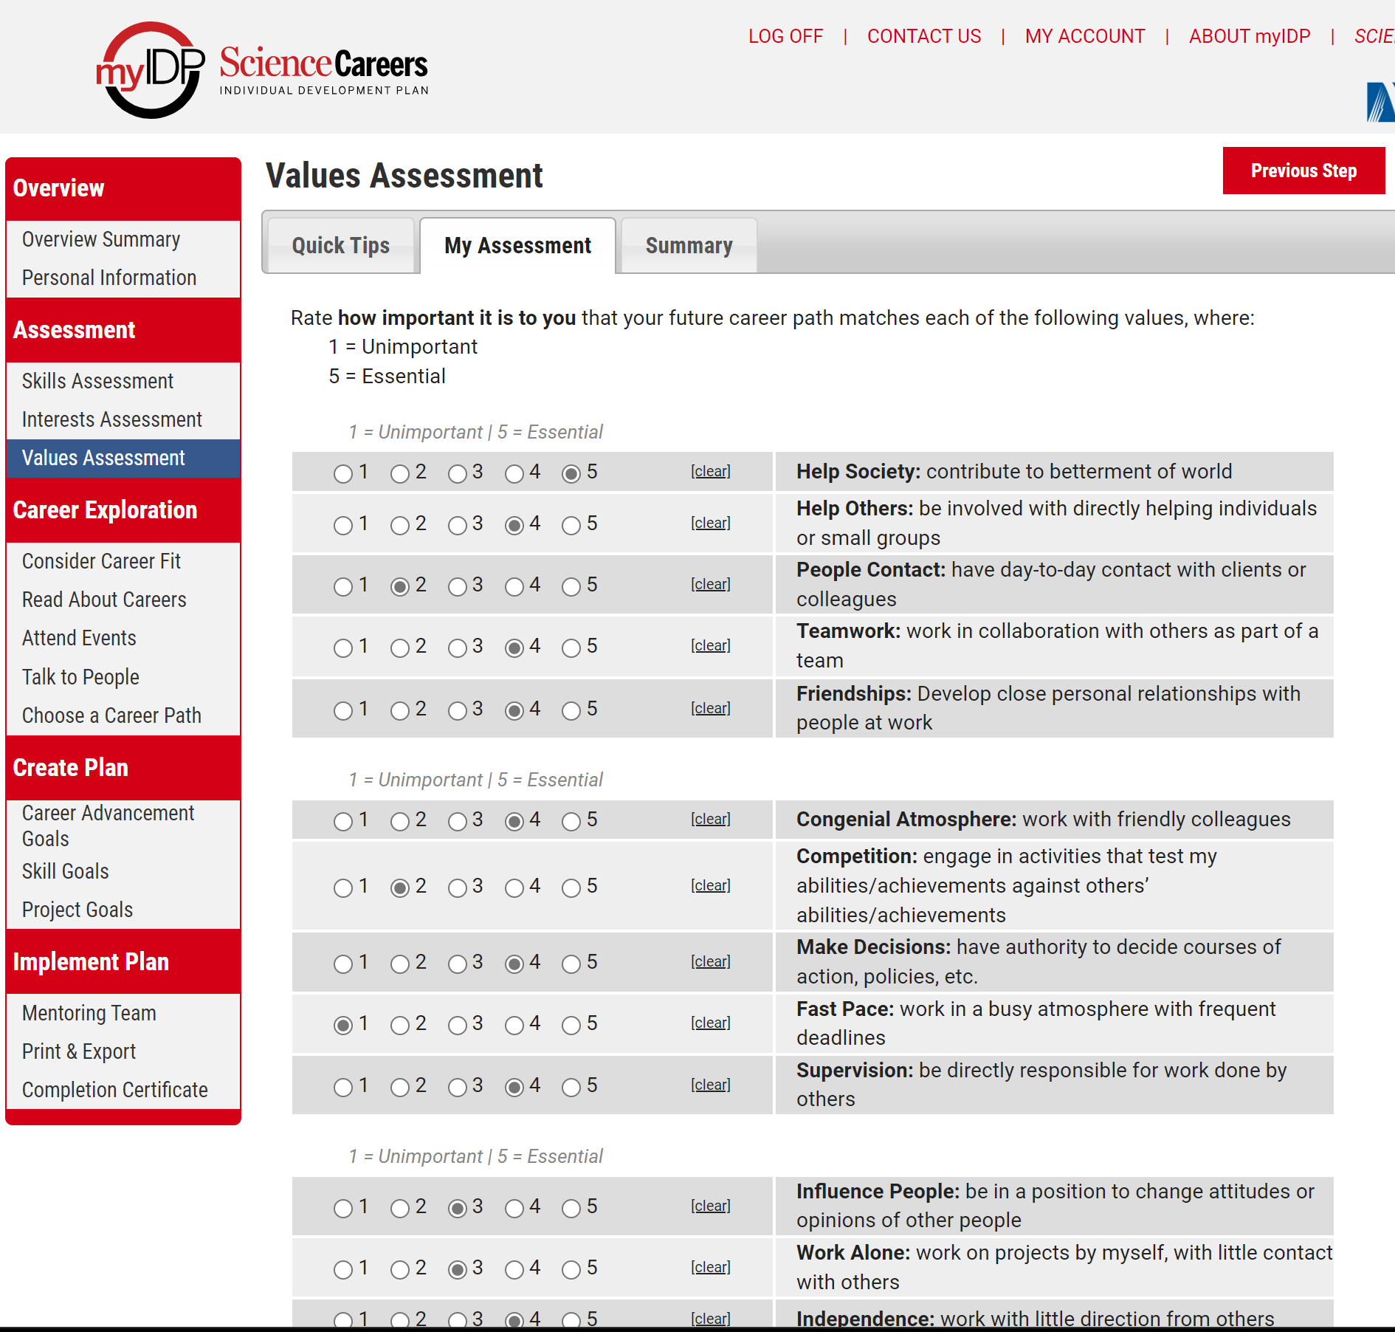

Slide 11
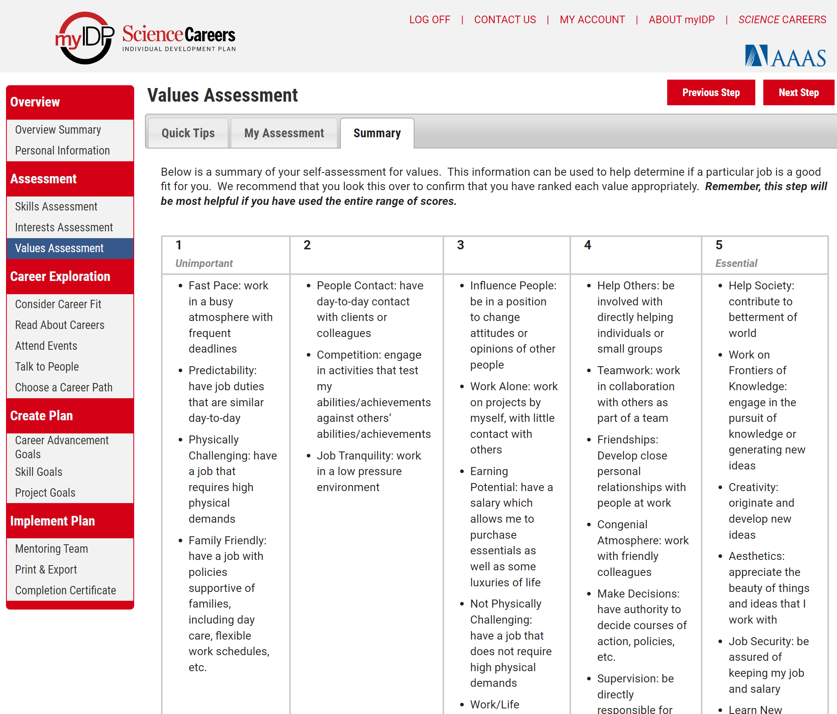

Slide 12
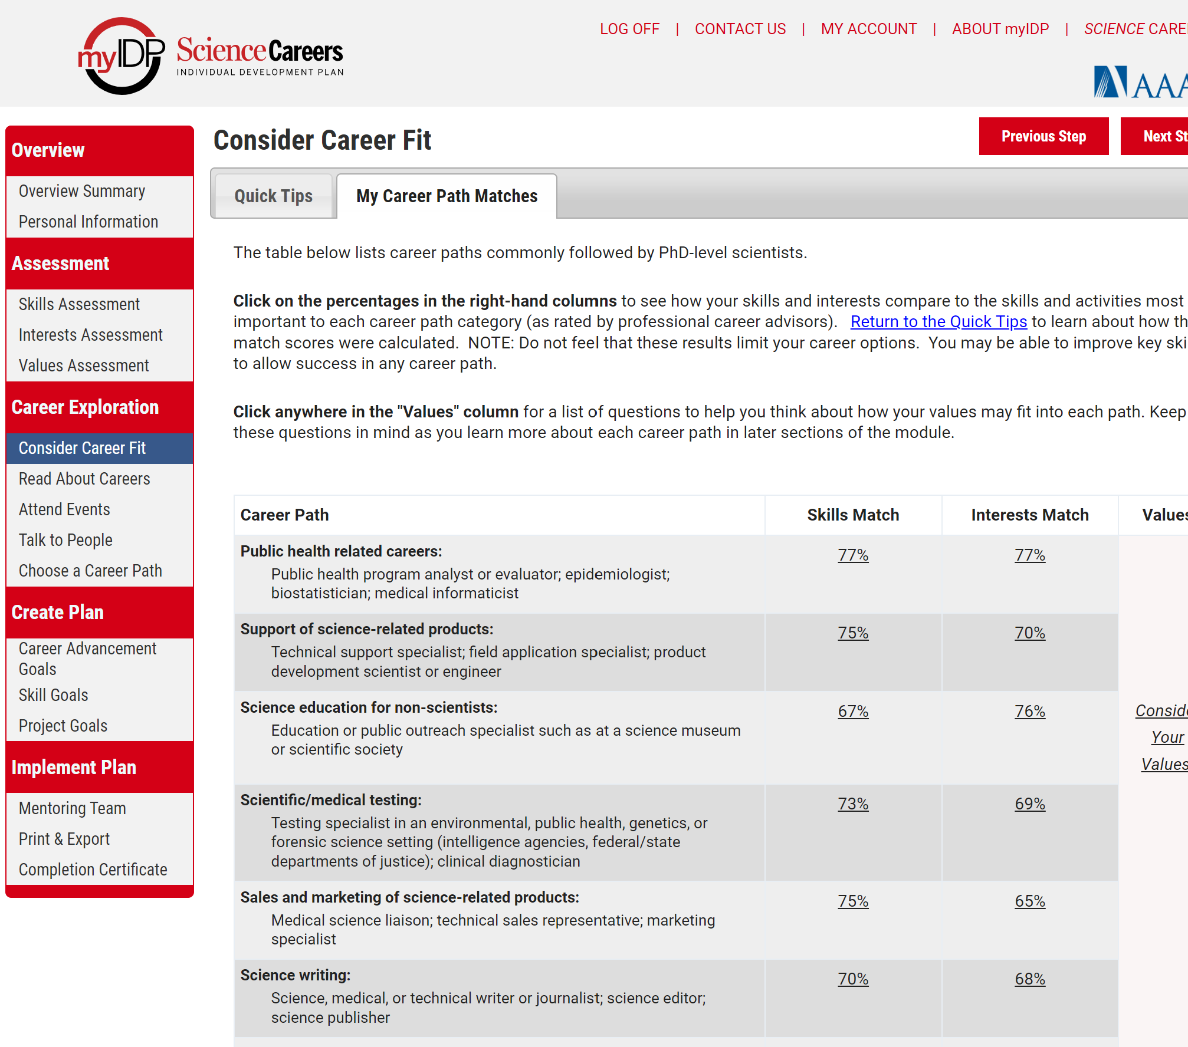

Slide 13
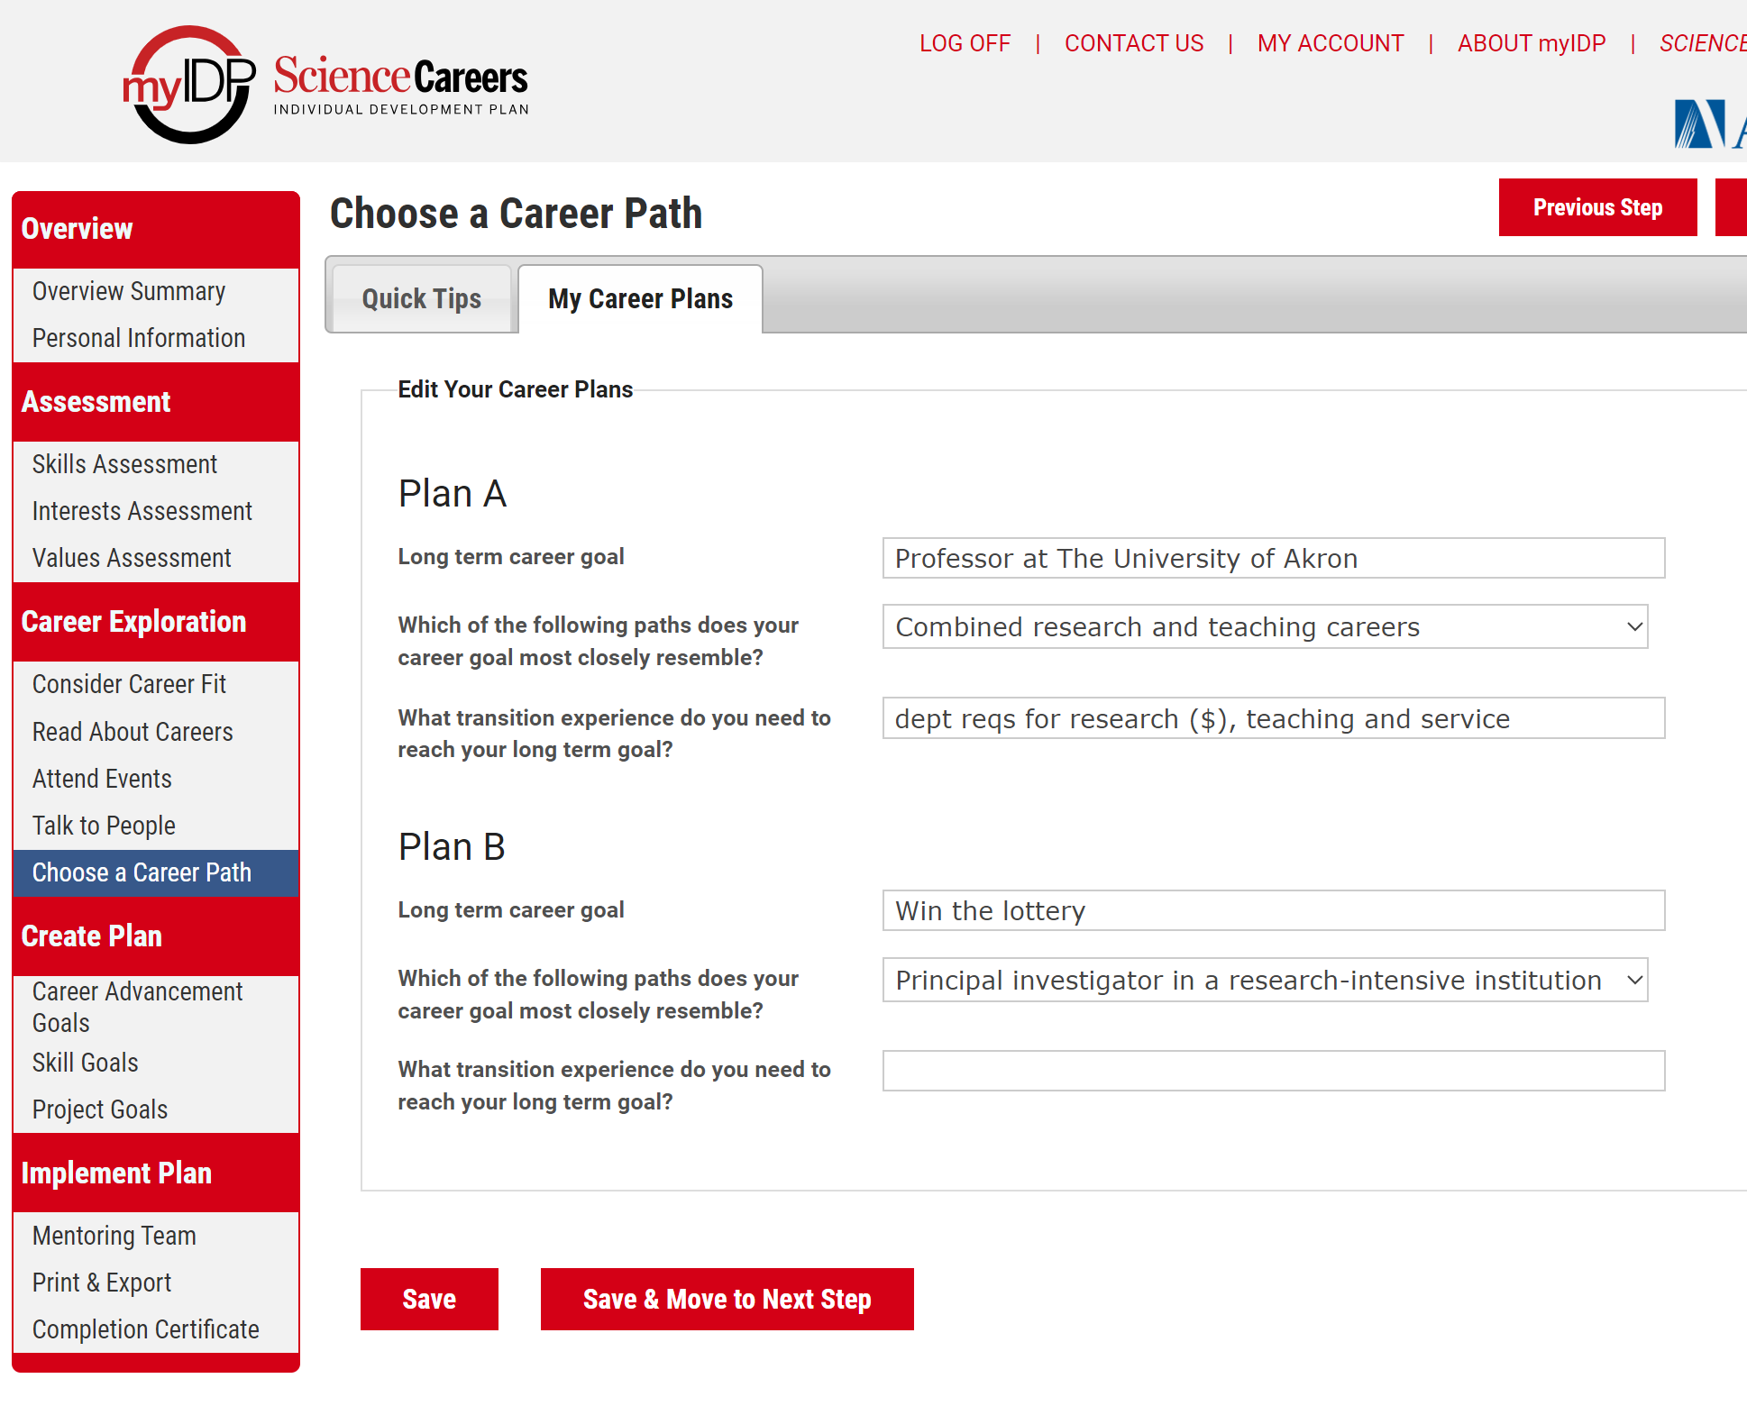

Slide 14
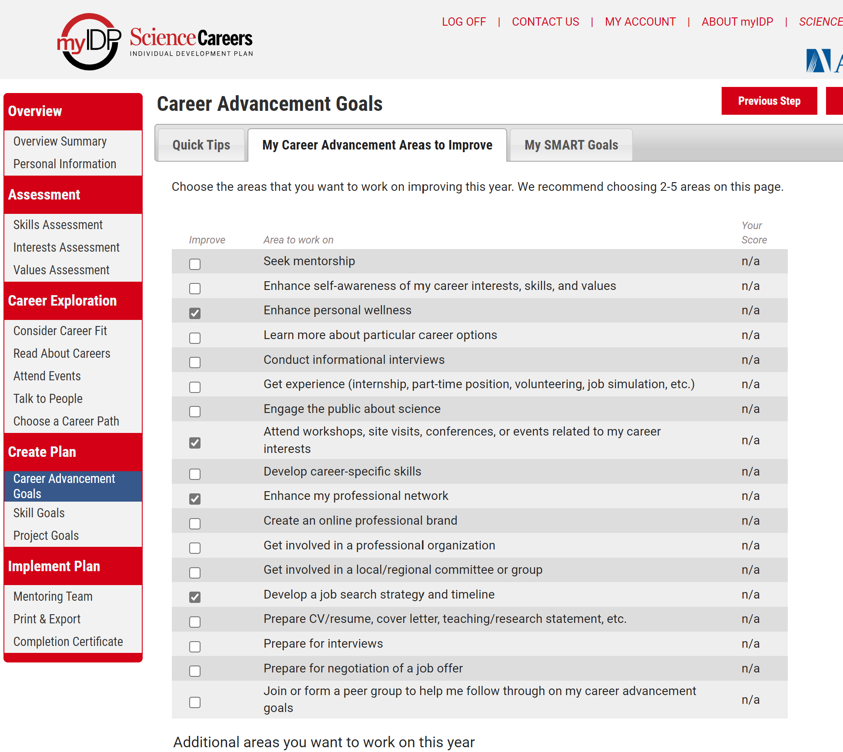

Slide 15
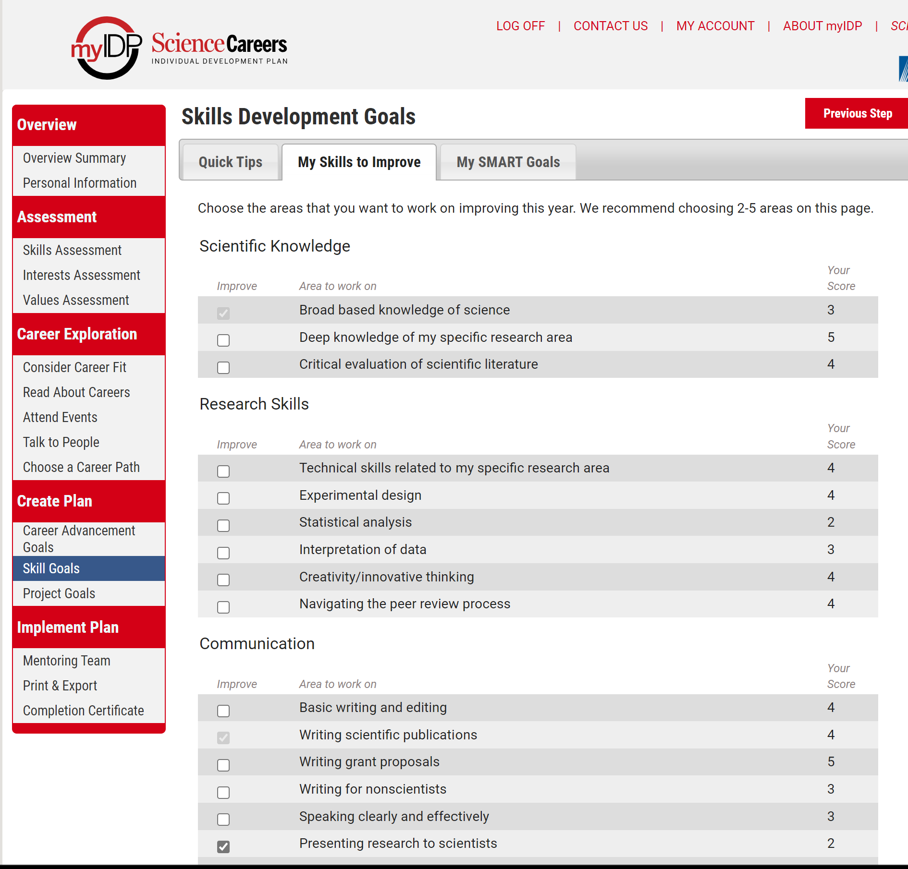

Slide 16
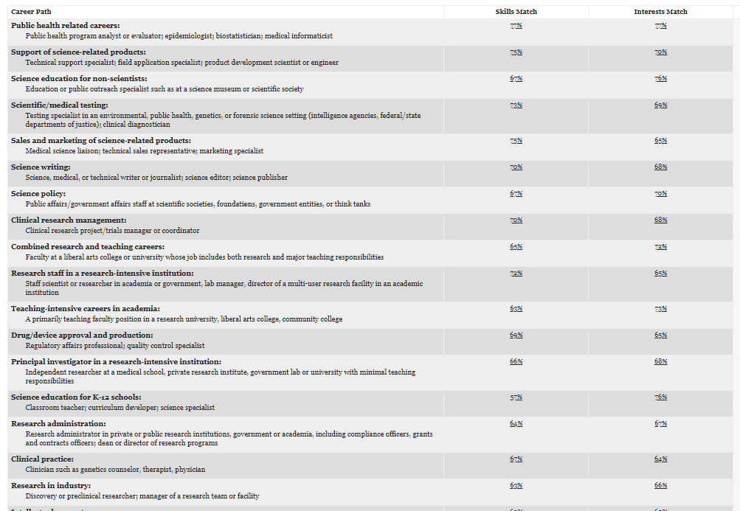
My IDP – take it with a grain of salt!

Slide 17
Final Thoughts
Great tool to help you consider options
Do not allow it to dictate – think for yourself
Great tool for charting milestones and forcing you to think in terms of acquiring skills
Great tool to log your career progress for your own edification

